Slide 1
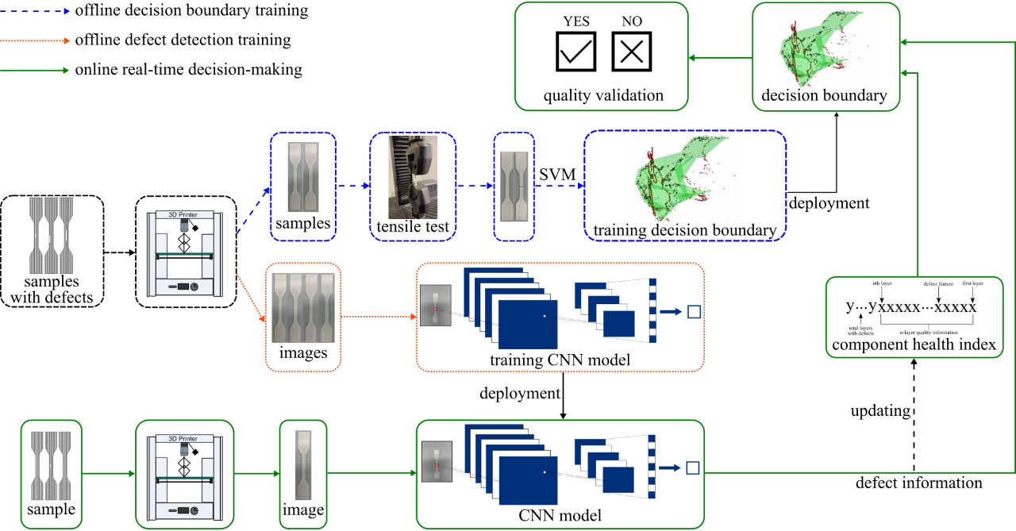
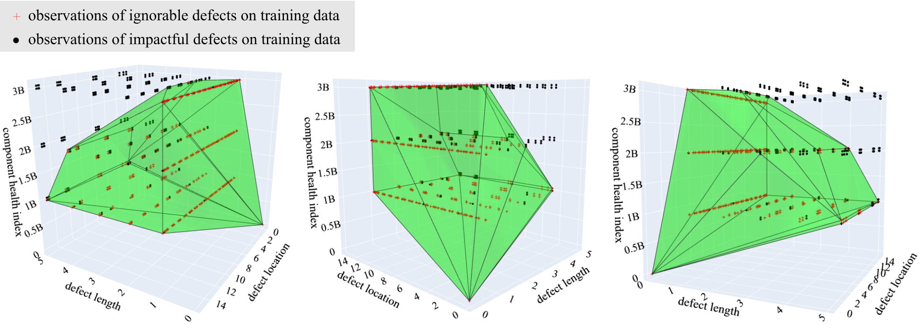
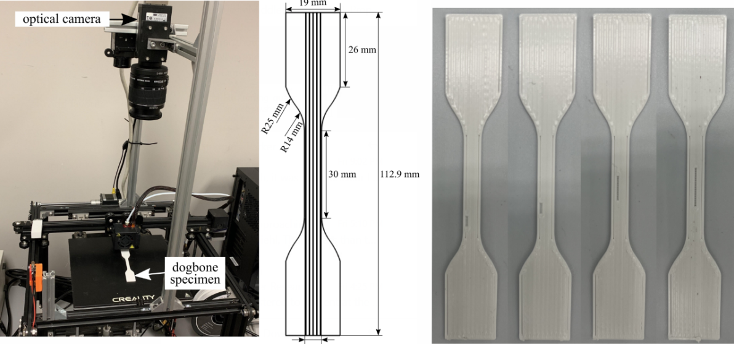
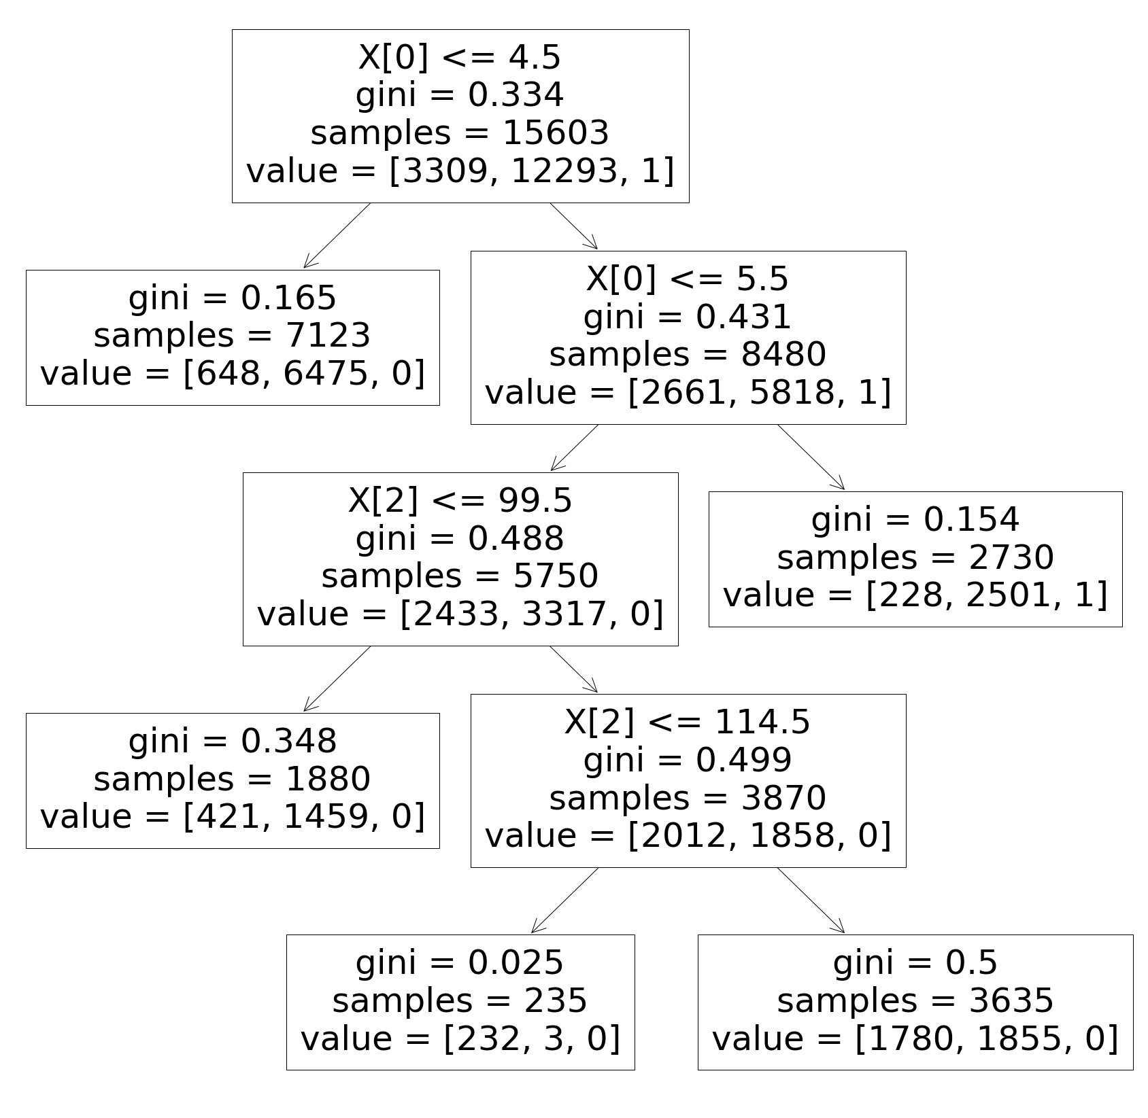
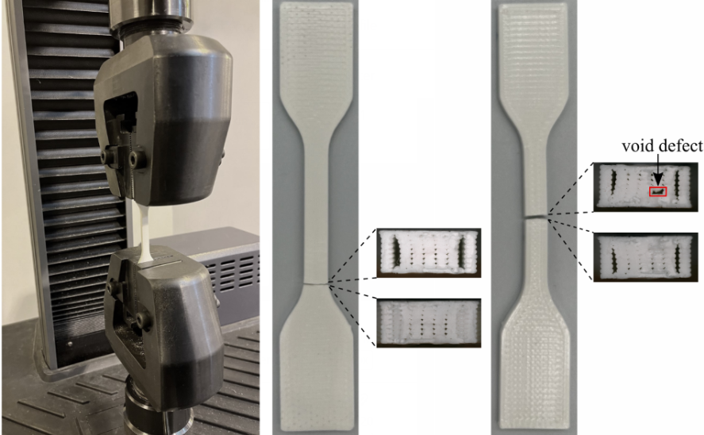
Research Poster 3-Column Template
Decision Making for Fused Filament Fabrication
Zachary Ziehl³, Yanzhou Fu¹, Austin R.J. Downey¹²
¹University of South Carolina, Department of Mechanical Engineering
²University of South Carolina, Department of Civil and Environmental Engineering
³University of South Carolina, Department of Computer Science and Engineering
Diagram for the Decision Making
Decision Boundary
Results
The original method of decision making was based on a 3D decision boundary made with support vector machine, which is . dependent on 3 variables.
Component health index
Defect location
Defect length
Decision Tree Classification Report
 | precision | recall | F1-score
Ignorable defect | 0.57 | 0.62 | 0.59
Impactful defect | 0.89 | 0.87 | 0.88
Accuracy |  |  | 0.82
Macro avg | 0.73 | 0.49 | 0.49
Weighted avg | 0.83 | 0.83 | 0.82
Data Gathering
Decision Tree With Gini Impurity
Decision Boundary Classification Report
 | precision | recall | F1-score
Ignorable defect | 0.83 | 0.34 | 0.48
Impactful defect | 0.85 | 0.98 | 0.91
Accuracy |  |  | 0.85
Macro avg | 0.84 | 0.66 | 0.69
Weighted avg | 0.84 | 0.85 | 0.82
Tensile Test
Conclusions
The confusion matrices for both the decision tree and the decision boundary methods are very similar in spread. Most difference values are in false positive and false negative.
Accuracy scores for both models are very similar.
The decision tree is not as visibly comprehensive as the decision boundary for this dataset and problem.
The decision tree has a good potential for more than three variables, otherwise, decision boundary can only handle for three variables.

